Slide 1


Azure OpenAI Unveiled: A Comprehensive Guide

Slide 2
Abstract
In this session, we'll discuss the basics of Azure OpenAI, what it can do, and how you can apply it in real-life situations. Whether you're new to Azure OpenAI or just need a quick reminder, this session is your starting point to get the most out of it. During our time together, we'll focus on three key technologies: Azure OpenAI Azure Data Factory Azure SQL By the end of the session, you'll have a solid understanding of Azure OpenAI and how to integrate it into your own projects.

Slide 3







Alpa Buddhabhatti
She/Her
Azure Data Engineer
Microsoft MVP
Microsoft Certified Trainer(MCT)
Azure Developer(AZ-204)
Azure Data Engineer(DP-203)
Azure Data Scientist(DP-100)
Azure Administrator(AZ-104)
alpabuddhabhatti
@AlpaB7
alpaBuddhabhatti/AzureOpenAI
@meetalpa
@alpabuddhabhatti

Slide 4
What Is Azure OpenAI
AI Tools
No Expertise Needed
Language Processing
Enhance Applications
Microsoft +OpenAI
Enterprise level security (Azure Private Link, Azure Active Directory, and Azure Role-Based Access Control to help you secure your network, identity, and access)
Businesses and developers can save time and resources while gaining valuable insights from their data

Slide 5
Few Examples
Chatbot App
Summarised your data
Q&A App
Ask Natural languages query to your Structure Data
Code generation
Media analysis

Slide 6
How to Consume Azure OpenAI
Azure OpenAI SDKs (c#, Python etc)
REST API (Endpoint , Key, etc)
Example:
curl $AZURE_OPENAI_ENDPOINT/openai/deployments/gpt-35-turbo-instruct/completions?api-version=2023-05-15 \
-H "Content-Type: application/json" \
-H "api-key: $AZURE_OPENAI_KEY" \
-d "{\"prompt\": \"Once upon a time\"}"

Slide 7







High Level Design
User
Private Data Sources
… etc
OR
Query
Response
Private Data
Knowledge
Public Data
OPEN DATA
06/03/2024
7

Slide 8
DEMO – For Public Data using Azure Portal
User
Query: 2+2=?
Response
2+2=4
Open
Data
Knowledge
Public Data
(Data over internet )
06/03/2024
8

Slide 9

DEMO - Integrate Azure OpenAi with ADF
1. Azure OpenAI Rest URL+API API Version
2. Method : POST
3. Header : Content-Type +Key
4. Message : Prompt
Query: 2+2=?
Response
2+2=4
Open
Data
Knowledge
Public Data
(Data over internet )
06/03/2024
9

Slide 10
DEMO – Consuming
Postman
Python
Fabric Notebook
How to use function calling with Azure OpenAI Service - Azure OpenAI Service | Microsoft Learn
06/03/2024
10

Slide 11
Prerequisites
Azure account.
Azure subscription with access enabled for the Azure OpenAI service.
You can request access with this form- Request Access to Azure OpenAI Service (microsoft.com)
3. Azure account permissions(subscription-level permissions OR RG level):
Microsoft.Authorization/roleAssignments/write permissions (such as Role Based Access Control Administrator, User Access Administrator, or Owner.)
Microsoft.Resources/deployments/write permissions on the subscription level.
You need App Registration (Client Id)

Slide 12


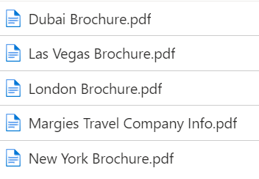
DEMO – Private Data
Response
List of hotel in Dubai from private data
Azure AI Search
Index
Keyword Search
Web App
(Chat BOT)
Azure OpenAI
User Query “Can you please suggest hotel in Dubai”
hotel-data
Internal Knowledge
based Data
06/03/2024
12

Slide 13
Integrate with ADF
Azure AI Search
Index
Keyword Search
Azure OpenAI
hotel-data
Internal Knowledge
based Data
06/03/2024
13

Slide 14

Demo
User Query : Show me finance data
Streamlit
Azure OpenAI
Select * from abo.Finance
Python
Database
NikhilSehgal123/azure-open-ai: Azure OpenAI (github.com)
06/03/2024
14

Slide 15
Search Type
Parameter | Definition | Example
Keyword | A word or phrase that matches the content of your documents | “cat”
Semantic | A parameter that enables semantic ranking, captions, and answers for your search queries | “What is the best pet for me?”

Slide 16
Keywords
Large Language Models (LLMs) : Prebuild model ChatGPT and GPT-4
Token: A token is a piece of text that the model reads or writes.
For example, “hello” is one token, and “.” is another token.
Prompt: A prompt is the text that you give to the model as input.
For example, “Write a poem about love” is a prompt.
Completion: A completion is the text that the model gives you as output based on the prompt.
For example, “Love is a feeling that fills the heart / With joy and warmth and light” is a completion.

Slide 17
Keywords
Embedding: An embedding is a number that represents the meaning of the text. For example, the embedding of “cat” is closer to the embedding of “dog” than to the embedding of “car”.
Temperature: Temperature is a number that controls how creative or predictable the model’s output is.
For example, with high temperature, the model might write “Love is a fire that burns the soul / With passion and fury and pain”.
With low temperature, the model might write “Love is a bond that connects two people / With trust and respect and care”.

Slide 18
Tips
Azure OpenAI:
Wait for some time
Refresh Azure OpenAI
Region
While consuming if you have
OpenAI ~ 0.28.1 or OpenAI >=1.0.0
How to use function calling with Azure OpenAI Service - Azure OpenAI Service | Microsoft Learn
Azure AI Search:
Select a plan of Semantic Search
Enable the service in your Service
Semantic Search
At list Basic Sku

Slide 19
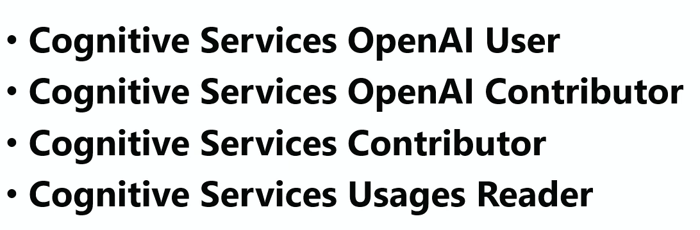
Role & Permission

Slide 20
Few more High-level design
06/03/2024
20

Slide 21

High Level Design
Response
Search Query
Web App
(chat BOT)
Prompt
(Content Filtering)
Blocked Harmful Prompt
e.g. Social media like
Twitter, Slack App
Azure Function, Notebooks , C# code etc
Index
Azure OpenAI
Azure AI Search
Keyword Search
Internal Knowledge based Data

Slide 22
High Level Design
Search Query
Index
e.g. Social media like
Twitter, Slack App
Azure OpenAI
Azure AI Search
Keyword Search
Internal Knowledge based Data

Slide 23
High Level Design
Search Query
Index
Search Query
Azure OpenAI
Internal query Data
Azure AI Search
Keyword Search
Internal Knowledge based Data

Slide 24
Alpa Buddhabhatti
Thank you!!
She/Her
Azure Data Engineer/Trainer
Microsoft MVP
Microsoft Certified Trainer(MCT)
Azure Developer(AZ-204)
Azure Data Engineer(DP-203)
Azure Data Scientist(DP-100)
Azure Administrator(AZ-104)
alpabuddhabhatti
@AlpaB7
alpaBuddhabhatti/AzureOpenAI
@meetalpa
@alpabuddhabhatti

Slide 25
Resources
slearn-openai (microsoftlearning.github.io)
NikhilSehgal123/Azure-OpenAI-SQL (github.com)
Use your own data with Azure OpenAI Service — Training | Microsoft Learn
https://learn.microsoft.com/en-gb/azure/ai-services/openai/quickstart?pivots=rest-api&tabs=command-line%2Cpython
https://github.com/Valentina-Alto/azure-open-ai-sql-data/blob/main/sql.ipynb
https://blazorhelpwebsite.com/ViewBlogPost/8067

